Slide 1





Spreadsheet Project:
IT Ticket Analysis
Presented by Prakamya Verma

Slide 2

Problem Statement
The objective is to analyze the IT support ticket management system to understand the performance of IT agents, the efficiency of ticket resolution, and the satisfaction levels of employees. The analysis aims to identify high and low performers among IT agents, assess the overall effectiveness of the team, and pinpoint areas for improvement in the ticket resolution process. The ultimate goal is to make informed staffing decisions, including hiring, firing, and training, to enhance overall service quality and team performance.

Slide 3
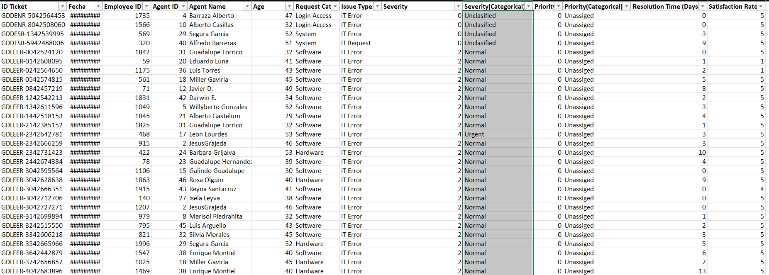
Tickets Sheet Data

Slide 4
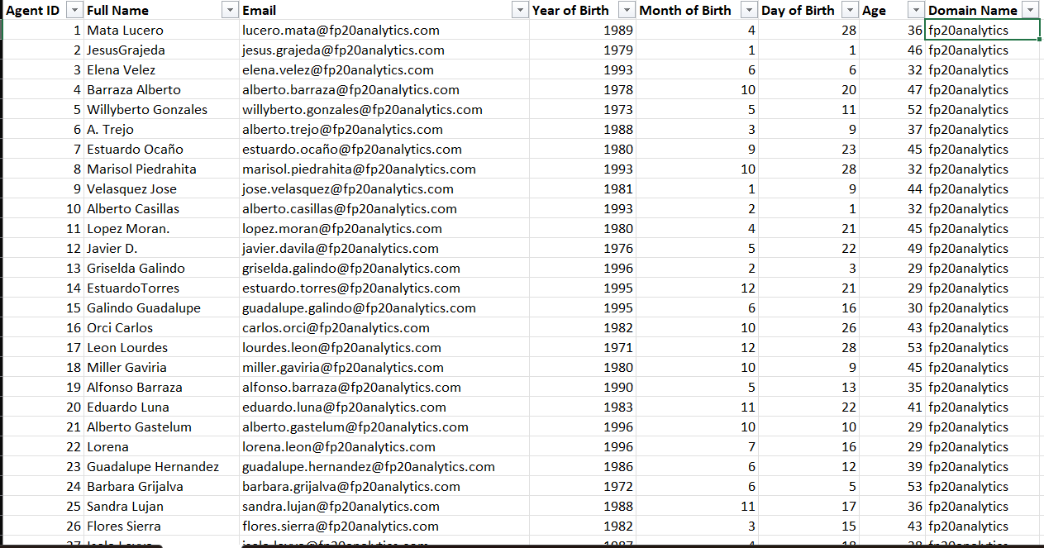
IT Agents Sheet Data

Slide 5
Data Attributes
Tickets Sheet: Contains information about IT support tickets.
ID Ticket: Unique identifier for the ticket.
Fecha: Date of the ticket.
Employee ID: ID of the employee who raised the ticket.
Agent ID: ID of the agent assigned to the ticket.
Request Category: Category of the request (e.g., Login Access, System, Software).
Issue Type: Type of issue (e.g., IT Error, IT Request).
Severity: Severity of the issue.
Priority: Priority level of the issue.
Resolution Time (Days): Time taken to resolve the ticket.
Satisfaction Rate: Satisfaction rate provided by the employee (1-5 scale).
IT Agents: Contains information about IT agents.
Agent ID: Unique identifier for the agent.
Full Name: Full name of the agent.
Email: Email address of the agent.
Year of Birth: Year the agent was born.
Month of Birth: Month the agent was born.
Day of Birth: Day the agent was born.

Slide 6
METHODOLOGY
1. Data Collection
Collected raw IT support data in Excel format.
Verified structure, data types, and column consistency.
2. Data Cleaning & Preparation
Checked for missing values — none found.
Used Find & Replace to correct spelling errors:
mayor → major
Unclasified → Unclassified
Unassiged → Unassigned
Separated combined Severity/Priority column using Text to Columns (Delimiter).
Created new fields: Severity Categorical and Priority Categorical.
Ensured consistent formatting of text, dates, and numeric fields.

Slide 7
METHODOLOGY
3. Data Analysis
Created Pivot Tables to summarize key metrics such as:
Tickets by Severity and Priority
Ticket Resolution Trends
Team Performance and Category-wise Analysis
4. Dashboard Development
Built an interactive Excel Dashboard
5. Insights & Reporting
Derived actionable insights on ticket resolution patterns.

Slide 8
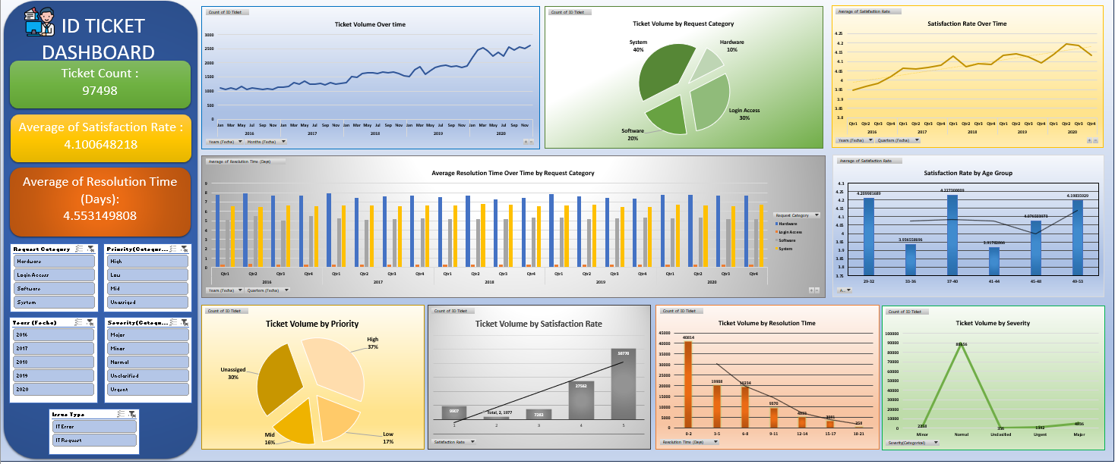
Dashboard

Slide 9
Ticket Volume Over time
Ticket volume grew consistently each year, peaking in 2020 with nearly 29K tickets.
The sharp rise in 2020 (≈35% increase from 2019) suggests higher system usage or remote-work impact.
Early years (2016–2017) saw lower ticket loads, showing maturing IT operations over time.
Growth trend indicates the need for scalable support processes and automation.

Slide 10
Satisfaction Rate Over Time
Customer satisfaction improved steadily from 3.98 in 2016 to 4.16 in 2020.
The highest quarterly satisfaction was in Q2 2020 (4.19) — showing improved responsiveness.
Consistent quarter-on-quarter growth reflects effective service quality initiatives.
Indicates that rising ticket volumes didn’t negatively impact user satisfaction.

Slide 11
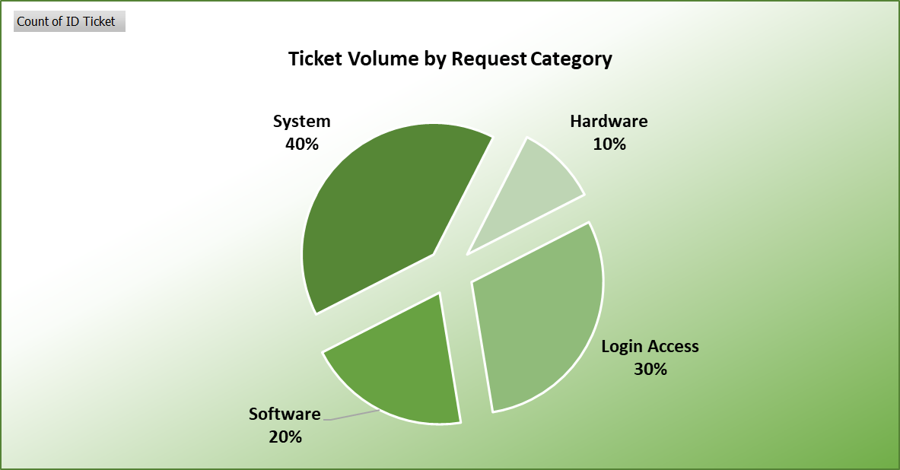
Ticket Volume by Request Category
System-related issues make up the largest share (40%), showing infrastructure dependency.
Login Access tickets (30%) suggest frequent credential or permission problems.
Software issues (20%) reflect ongoing application-level support demand.
Hardware issues (10%) are minimal, indicating stable physical setups.
Focus should shift to reducing recurring system and login access issues via preventive measures.

Slide 12
Satisfaction Rate by Age Group
Agents aged 37–40 achieved the highest satisfaction (4.23), indicating strong performance and experience balance.
The 33–36 and 41–44 age groups showed lower satisfaction (~3.9), suggesting possible workload or engagement issues.
Younger (29–32) and senior (49–53) agents maintained above-average satisfaction, showing consistent service delivery.
Overall satisfaction (4.10) remains strong across age groups, but targeted training or support for mid-career agents could enhance performance consistency.

Slide 13
Ticket Volume by Priority
High-priority tickets dominate (36%), reflecting a large volume of critical issues that demand quick resolution.
Unassigned tickets (30%) represent a major backlog area and indicate workflow or allocation inefficiencies.
Medium (16%) and Low-priority (17%) tickets are relatively balanced, showing stable distribution of routine requests.
Focus should be on reducing unassigned and high-priority backlogs through better ticket triaging and resource planning.

Slide 14
Ticket Volume by Satisfaction Rate
Majority of tickets (52%) received a perfect satisfaction score (5) — indicating strong service quality overall.
Over 80% of ratings are 4 or above, showing consistently positive user experiences.
Low ratings (1–2) account for about 12%, highlighting a minor segment of dissatisfied customers.
Continuous focus on root-cause analysis for low-rated tickets can further improve overall satisfaction levels.

Slide 15
Summary of Findings
Average resolution time shows moderate variation among agents, indicating differences in efficiency and workload handling.
Satisfaction levels are consistently high (avg. ≈ 4.1/5), demonstrating strong overall service quality.
System and Login Access issues form ~70% of all tickets — revealing key focus areas for preventive solutions.
Most tickets are low-to-medium severity, but high-priority and unassigned cases need closer monitoring.
Weak correlation observed between Resolution Time and Satisfaction Rate, suggesting that employee satisfaction depends more on service quality and communication than on ticket speed alone.
Ticket volumes have steadily increased, showing the need for scalable support infrastructure.

Slide 16
Recommendations
Agent Training & Support: Provide coaching to agents with higher resolution times to balance team performance.
Automated Ticket Routing: Implement category- and priority-based auto-assignment to minimize unassigned tickets.
SLA Tracking: Strengthen monitoring of high-severity and overdue tickets to ensure timely resolution.
Preventive Measures: Reduce repetitive System / Login Access issues via proactive maintenance and access-management policies.
Recognition Program: Introduce a quarterly rewards system for top-performing agents to sustain motivation.
Focus on Quality of Interaction: Since satisfaction is not strongly tied to resolution speed, train agents to improve communication and problem-solving clarity.

Slide 17
THANK
YOU

